Slide 1
Module 5 : HBASE
By:
Dr. Rashmi L Malghan

Slide 2
AGENDA:
Why we need HBASE
Limitations of HADOOP
What is Apache HBASE
Difference between HDFS & HBASE
HBASE Storage
HBASE Components
Why HBase
HBAE
Characteristics
History of HBASE
RDBMS V/S HBASE
NOSQL
HBASE Features
Types of NOSQL
HBASE Architecture
HBASE Read & Write
Hierarchy Of objects
Case Study
Summary Of HBASE
Commands of HBASE

Slide 3
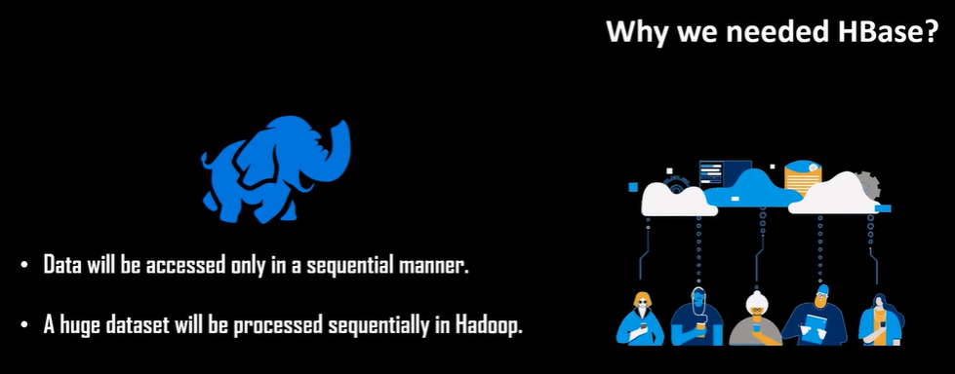
Why HBASE?

Slide 4
Limitations of HADOOP
Advantages :
Huge data storage
Data accessed – Sequential manner
Disadvantage/Limitations:
To fetch few records it take long time.
It has scan for entire distributed file system – To fetch small record
Hadoop doesn’t provide random access to database
Solution
“HBASE”

Slide 5
APACHE HBASE: Definition
HBASE: Opensource non-relation distributed database written in Java. It is developed as part of “Apache Software Foundation’s ” Apache Hadoop project and runs on “Top of HDFS”.
Its a column-oriented database built on top of HDFS.
Open-source project and “Horizontally Scalable”
HBASE – Data Model – Similar – “Google’s Big Data Table”.
Designed – To provide quick random access to huge amounts of structured data.
It leverages the “fault tolerance” provided by Hadoop file system and it is part of Hadoop ecosystem.
It provides “random real –time read and write access to the data in HDFS

Slide 6
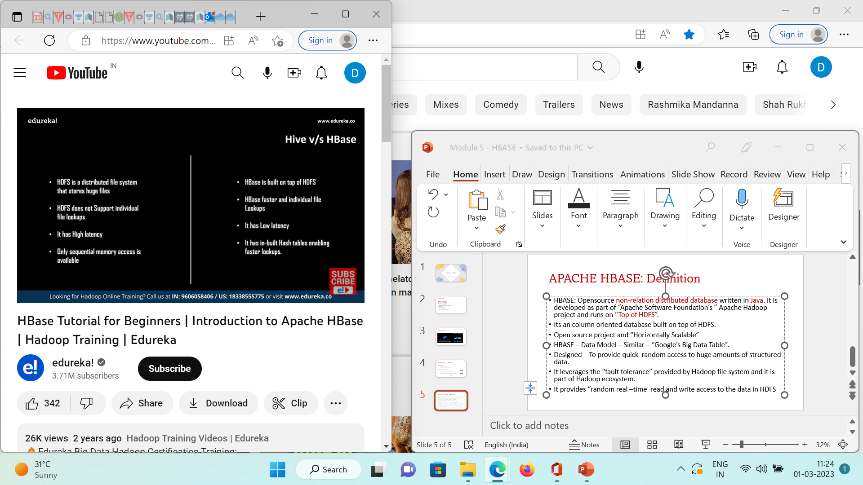
HDFS VS HBASE

Slide 7
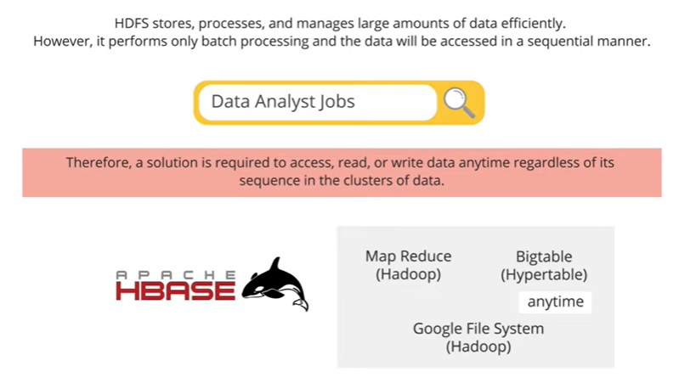
Why HBase:

Slide 8
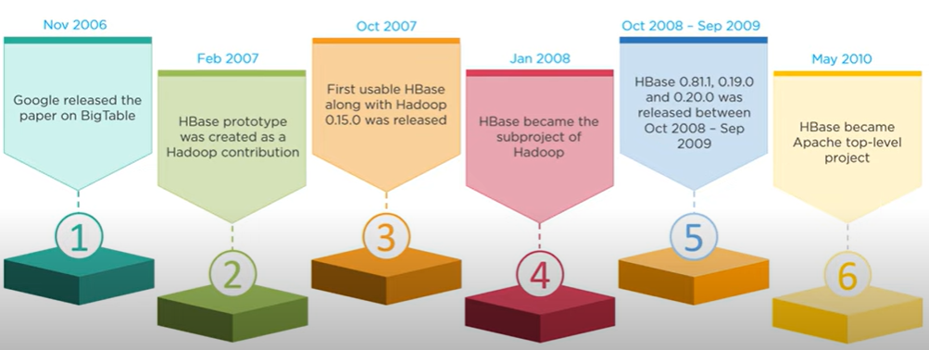
History of HBase

Slide 9

Companies using Hbase:

Slide 10
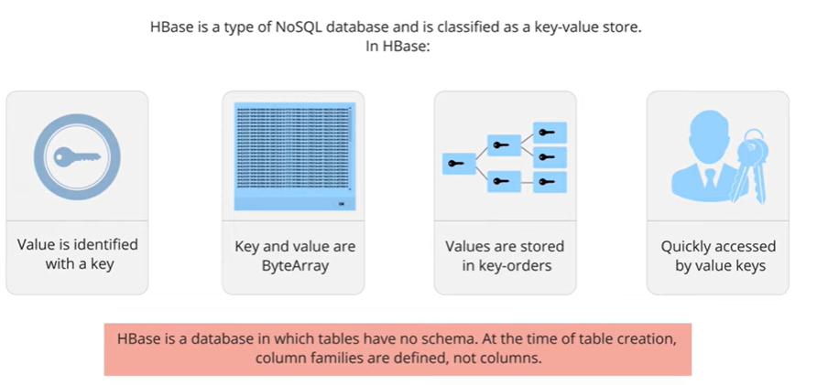
Characteristics of HBase:

Slide 11
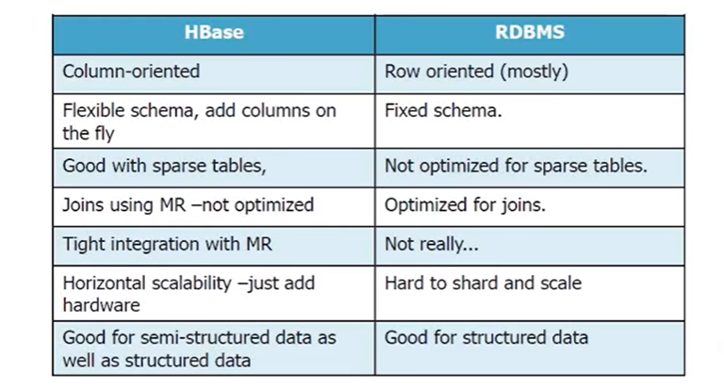
RDBMS Vs. HBase

Slide 12
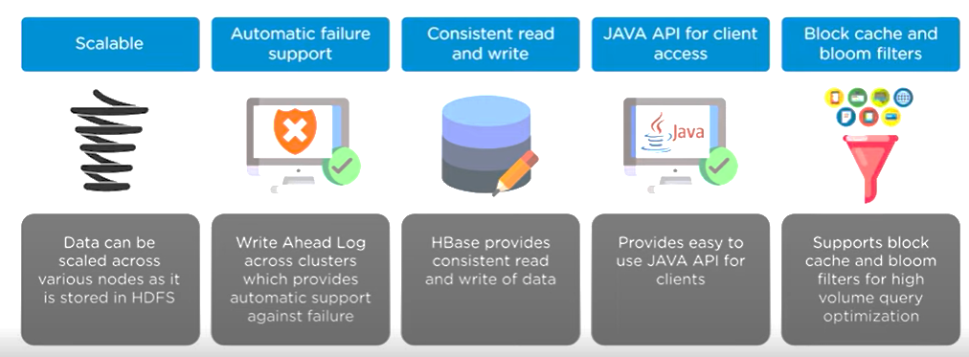
HBase Features:

Slide 13
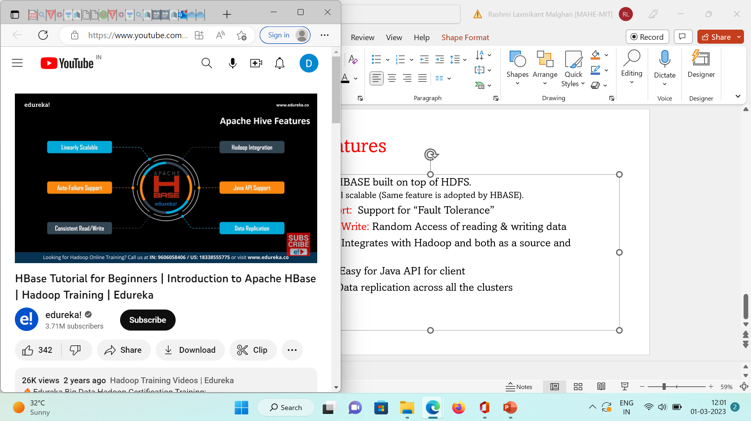
HBASE Features
Linear Scalable : HBASE built on top of HDFS.
HDFS – Horizontal scalable (Same feature is adopted by HBASE).
Auto Failure Support: Support for “Fault Tolerance”
Consistent Read / Write: Random Access of reading & writing data
HDFS Integration: Integrates with Hadoop and both as a source and destination
Java API Support: Easy for Java API for client
Data Replication: Data replication across all the clusters

Slide 14
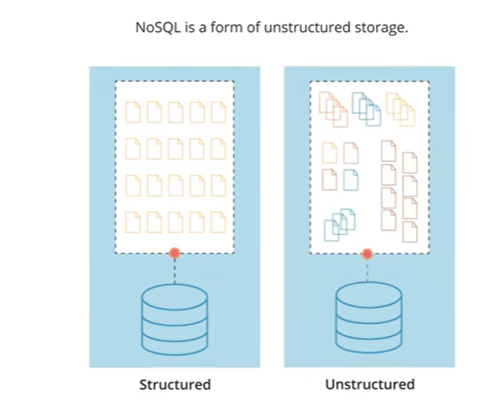
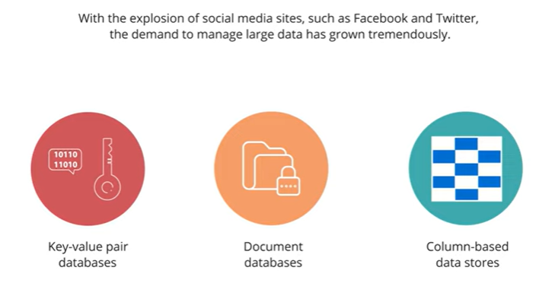
NoSQL:

Slide 15
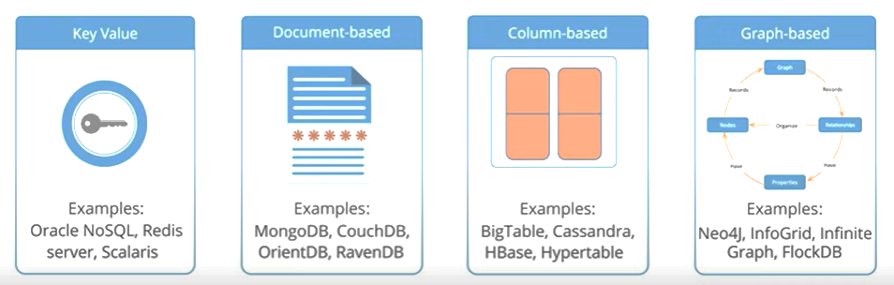
Types of NoSQL:

Slide 16
Types of NoSQL:
Key value :
Every data element in the database is stored as a key value pair consisting of an attribute name (or "key") and a value. In a sense, a key-value store is like a relational database with only two columns: the key or attribute name and the value.
The data can be retrieved by using a unique key allotted to each element in the database. The values can be simple data types like strings and numbers or complex objects.
document database:
It stores data in JSON, BSON, or XML documents (not Word documents or Google Docs, of course). In a document database, documents can be nested. Particular elements can be indexed for faster querying.
Documents can be stored and retrieved in a form that is much closer to the data objects used in applications which means less translation is required to use these data in the applications. In the Document database, the particular elements can be accessed by using the index value that is assigned for faster querying.

Slide 17
Types of NoSQL: Key value
A column-oriented database is a non-relational database that stores the data in columns instead of rows. That means when we want to run analytics on a small number of columns, you can read those columns directly without consuming memory with the unwanted data.
Columnar databases are designed to read data more efficiently and retrieve the data with greater speed. A columnar database is used to store a large amount of data. Key features of columnar oriented database:
Scalability.
Compression.
Very responsive.
A graph database focuses on the relationship between data elements. Each element is stored as a node (such as a person in a social media graph). The connections between elements are called links or relationships. In a graph database, connections are first-class elements of the database, stored directly.
Key features of graph database:
In a graph-based database, it is easy to identify the relationship between the data by using the links.
The Query’s output is real-time results.
The speed depends upon the number of relationships among the database elements.

Slide 18
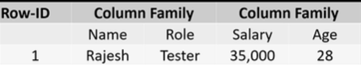
HBASE – Storage Mechanism
It is “Column - Oriented” database
Tables – Sorted by – Row.
Table Schema – Defines – Only Column families (which are Key –Value Pairs).
Table – Collection of Rows
Rows – Collection of Column Families
Column Families – Collection of Column
Column – Collection of key value pairs.

Slide 19
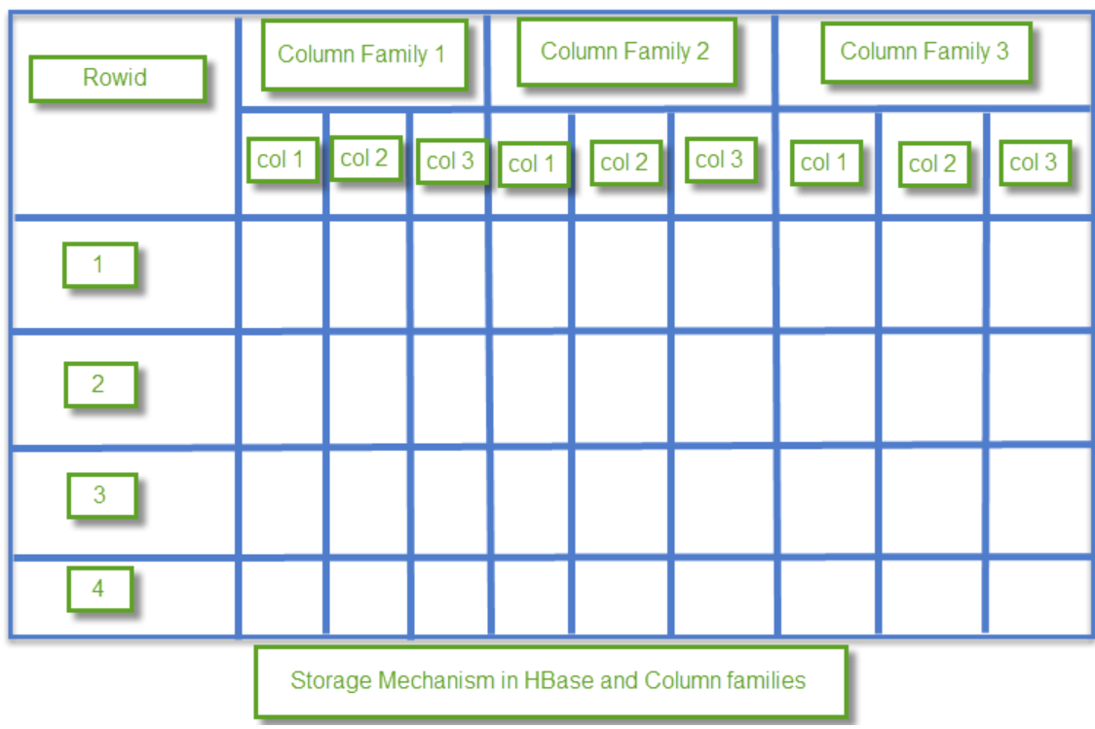
HBASE – Storage Mechanism
HBase is a column-oriented database and data is stored in tables.
The tables are sorted by RowId. As shown, HBase has RowId, which is the collection of several column families that are present in the table.
The column families that are present in the schema are key-value pairs.
If we observe in detail each column family having multiple numbers of columns.
The column values stored into disk memory.
Each cell of the table has its own Metadata like timestamp and other information.

Slide 20
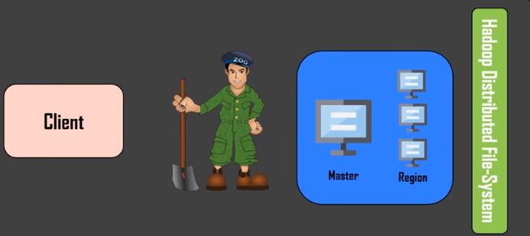
HBASE :Major Components
Client library
Master Server
Region Server

Slide 21
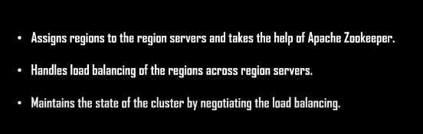
1.Master Server:

Slide 22
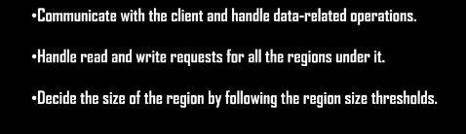
2. Region :
Regions – Nothing but “Tables”
Tables – split up across the “region servers”.

Slide 23
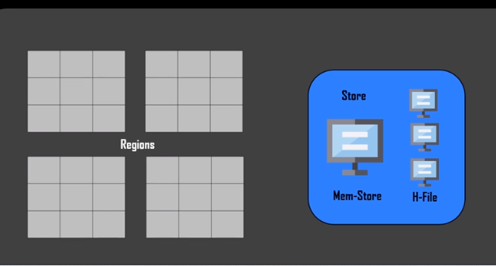
3. Region Server
Store - Contains “memory file” & “H- File” .
Mem- store – Just like cache memory.
Anything that is entered in “HBASE” is automatically stored initially.
Later the data is transferred and saved in H-Files as “blocks”.
Later the mem-store is erased out .

Slide 24
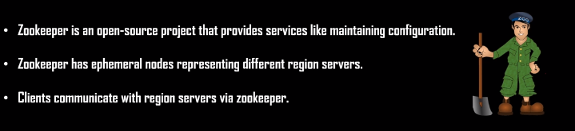
Zookeeper
Zookeeper: Providing Distributed synchronization, Naming etc
It has ephemeral node: Master servers use these nodes to discover available nodes.
Based on availability: Nodes are also used to track server failure or network partitions.
In sudo / stand alone mode: HBASE itself take care of Zookeeper

Slide 25
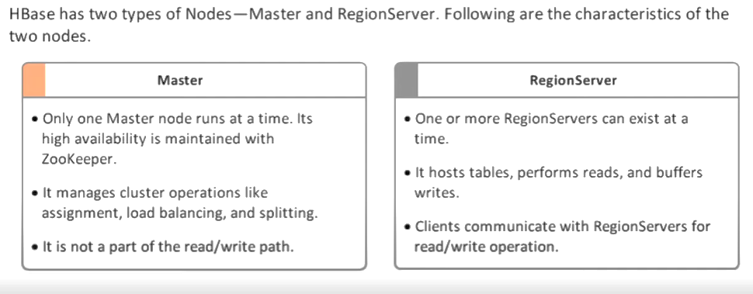
HBase Architecture:

Slide 26
HBASE - ARCHIZTECTURE
Inside HBASE: Tables are split into “Regions”.
Regions – Served by – Server Regions.
Regions Servers– Vertically Divided by “column families” into stores.
Stores – are saved as files in HDFS.
HBASE – 3 components
Client library
Master Server
Region Server

Slide 27
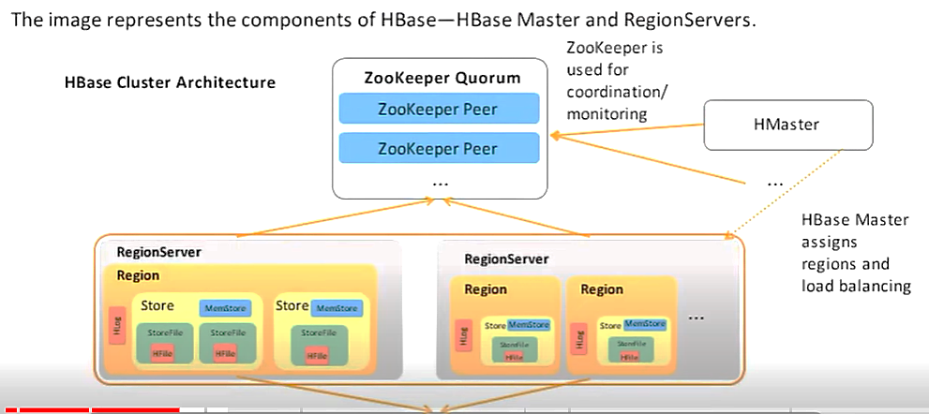
HBase Architecture:
HDFS

Slide 28
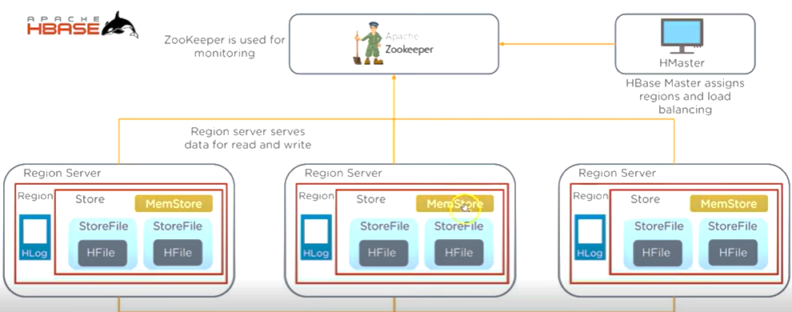
HBase Architecture:
HDFS

Slide 29
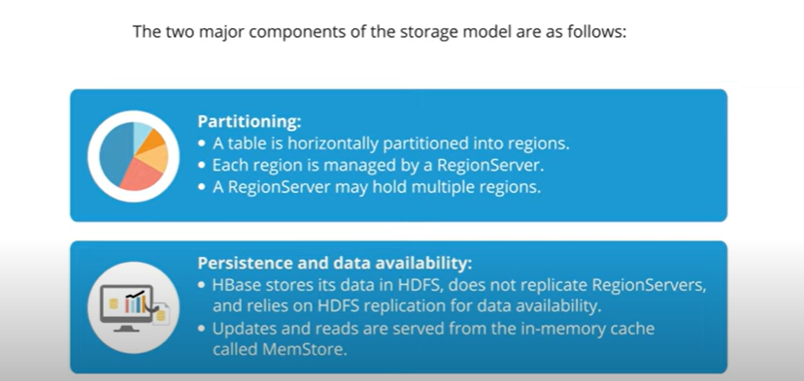
Storage Model of HBase:

Slide 30
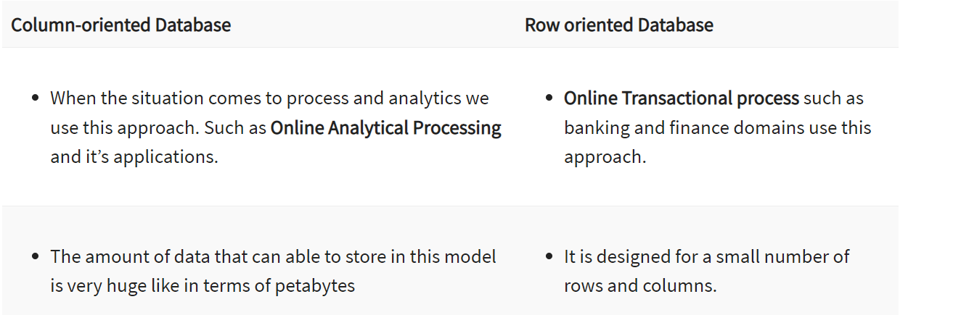
Column – Oriented v/s Row Oriented

Slide 31
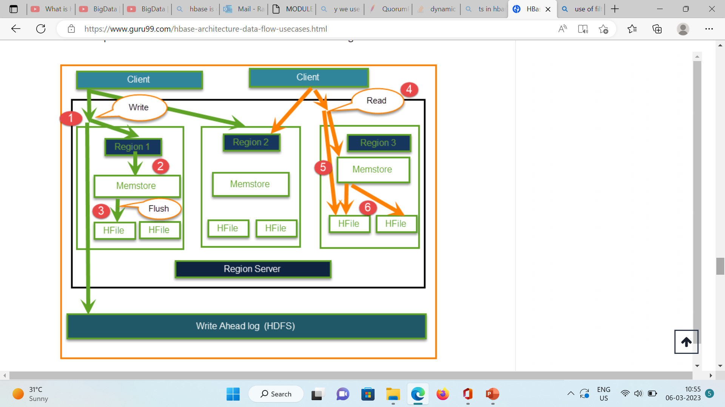
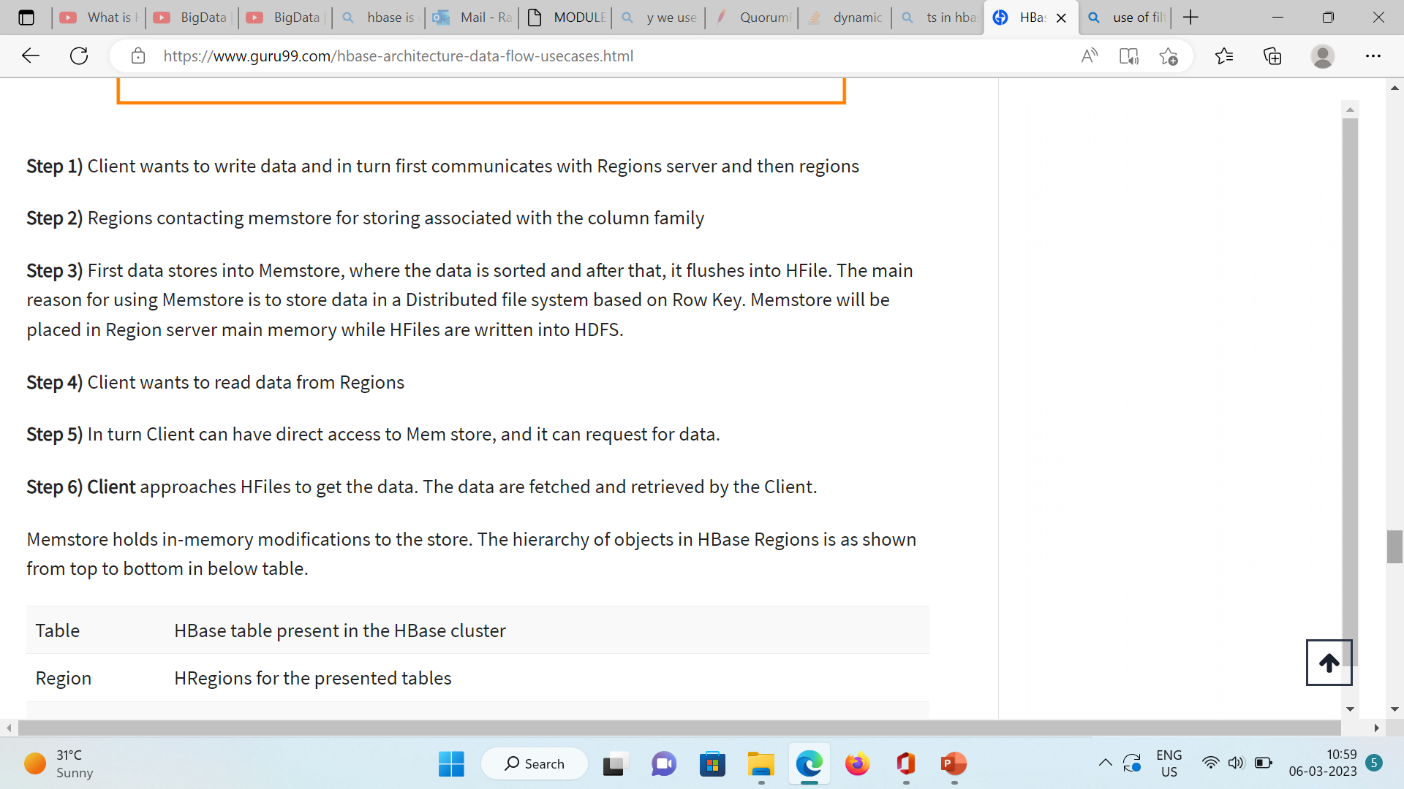
HDFS – Read & Write Data

Slide 32
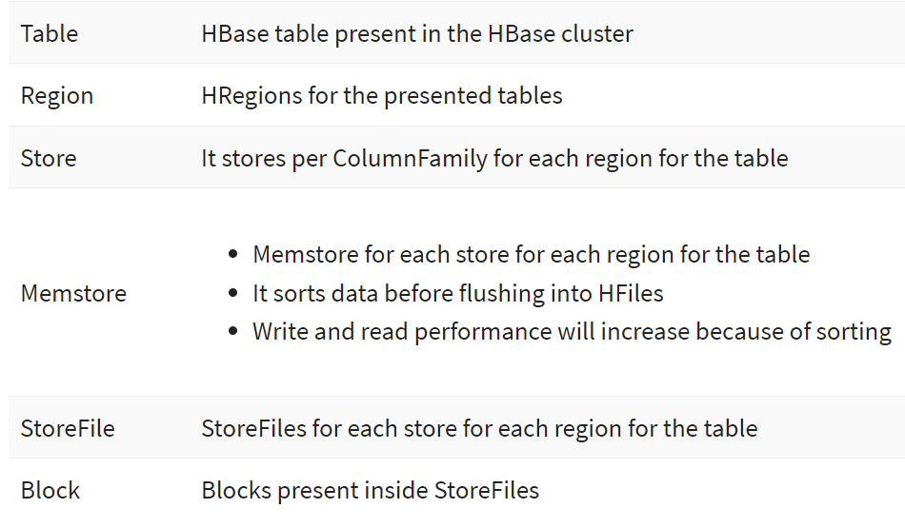
Hierarchy of Objects:
Memstore holds in-memory modifications to the store.
The hierarchy of objects in HBase Regions is as shown from top to bottom in below table.

Slide 33
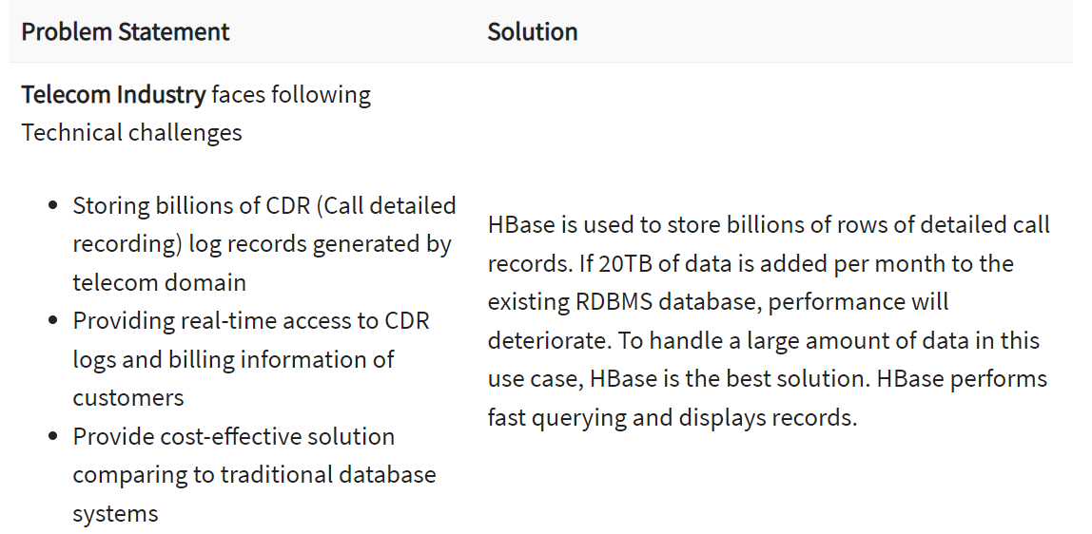
Case Study : Telecom

Slide 34
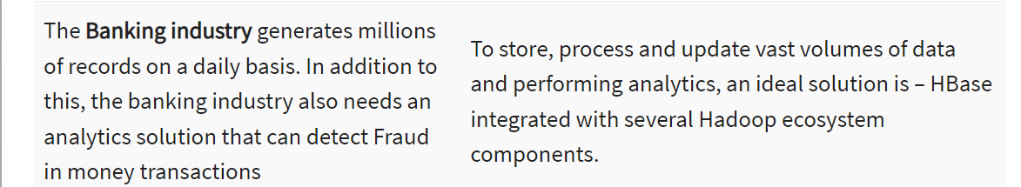
Case Study : Banking
When to Use Hbase:
Whenever there is a need to write heavy applications.
Performing online log analytics and to generate compliance reports.

Slide 35
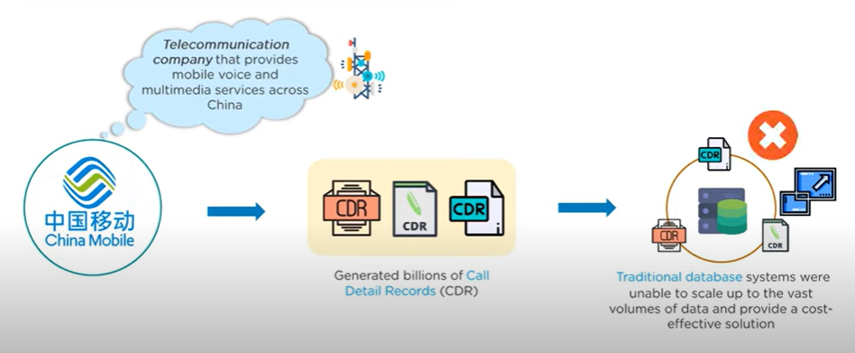
HBase Use Case:

Slide 36
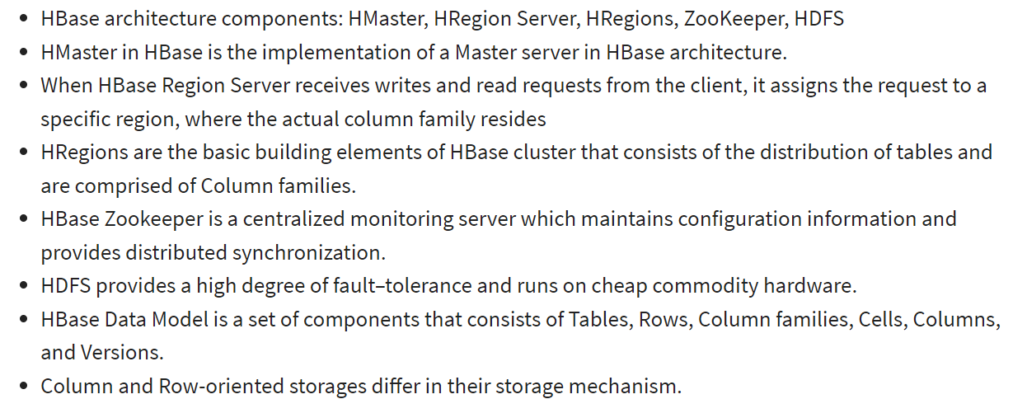
Summary – HBASE:

Slide 37
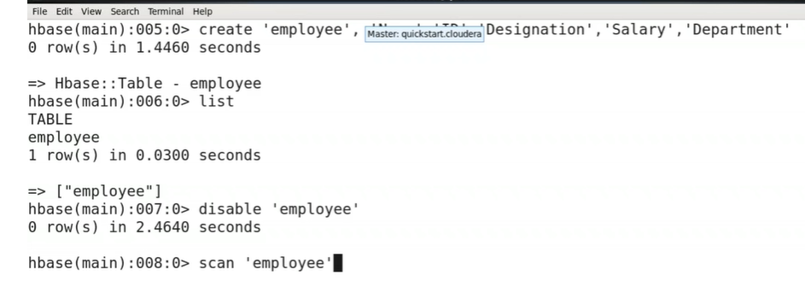
Commands: HBASE

Slide 38
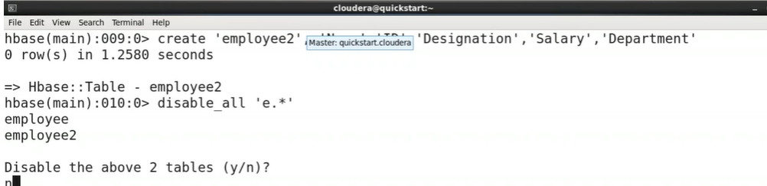

Slide 39
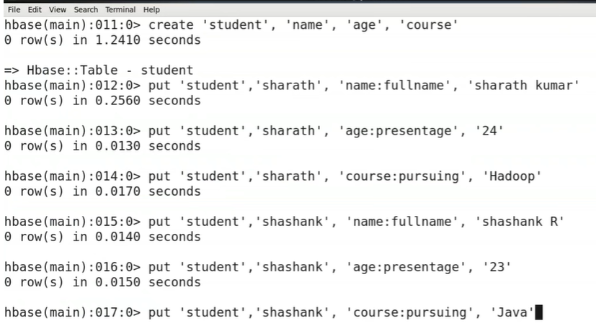
Adding Data – Table

Slide 40
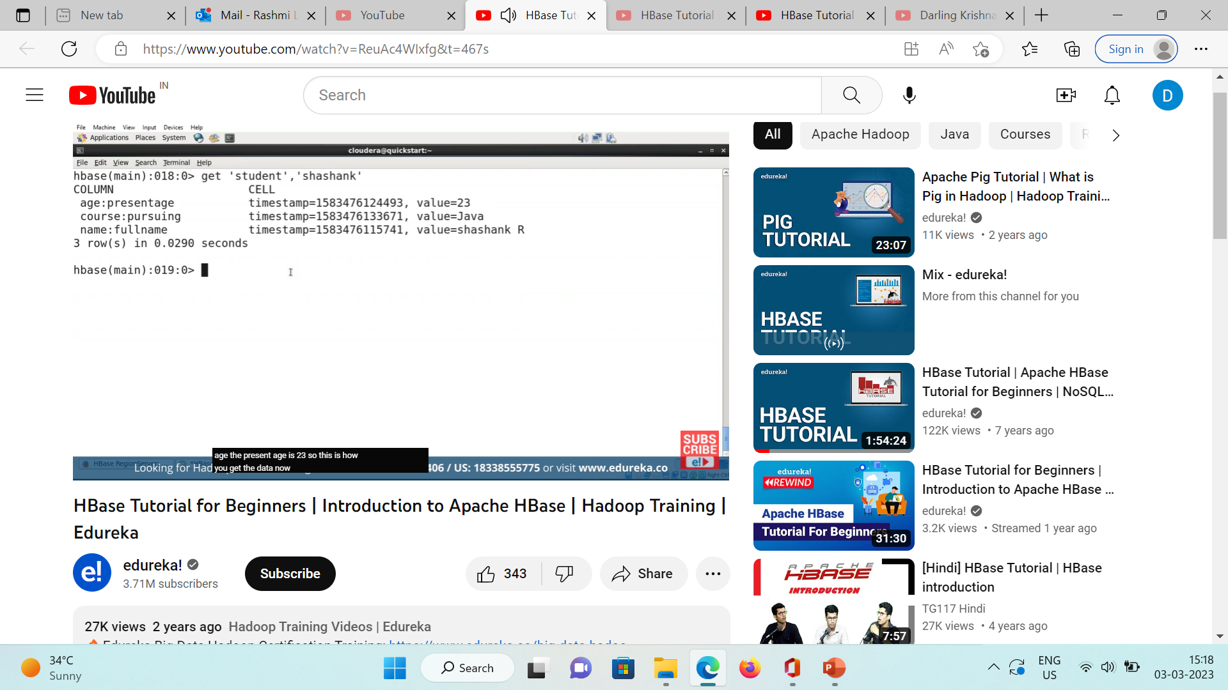
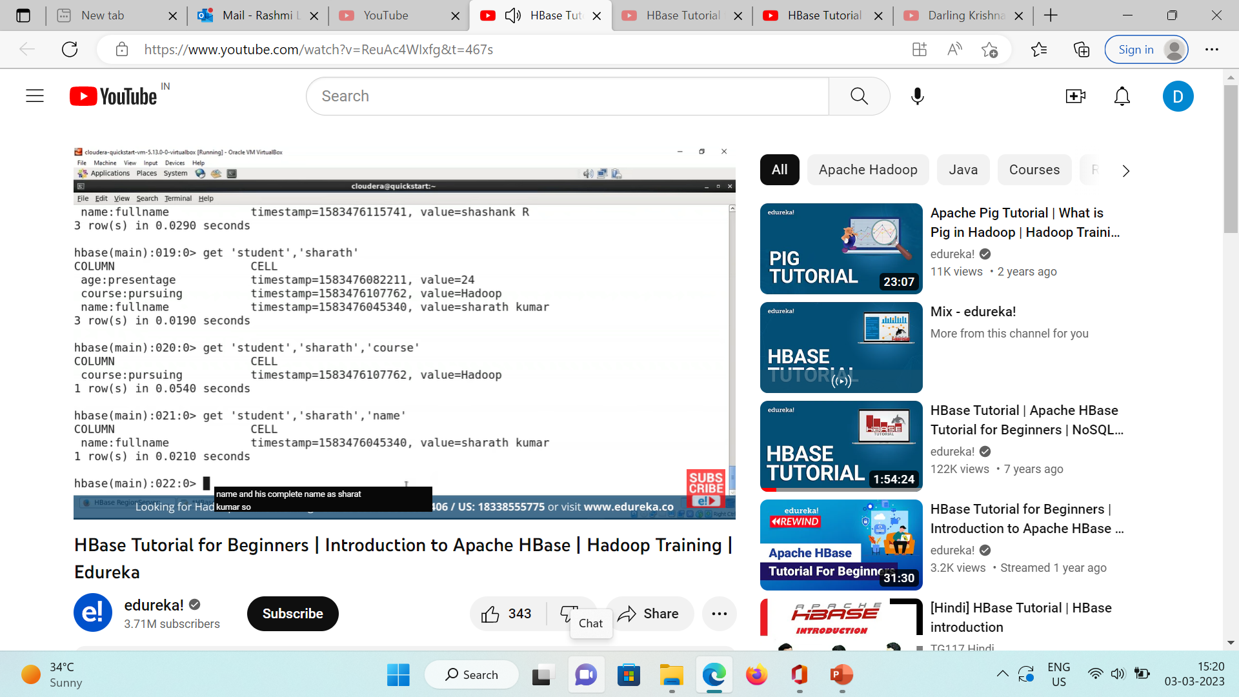
Entire Record / Specific Record

Slide 42
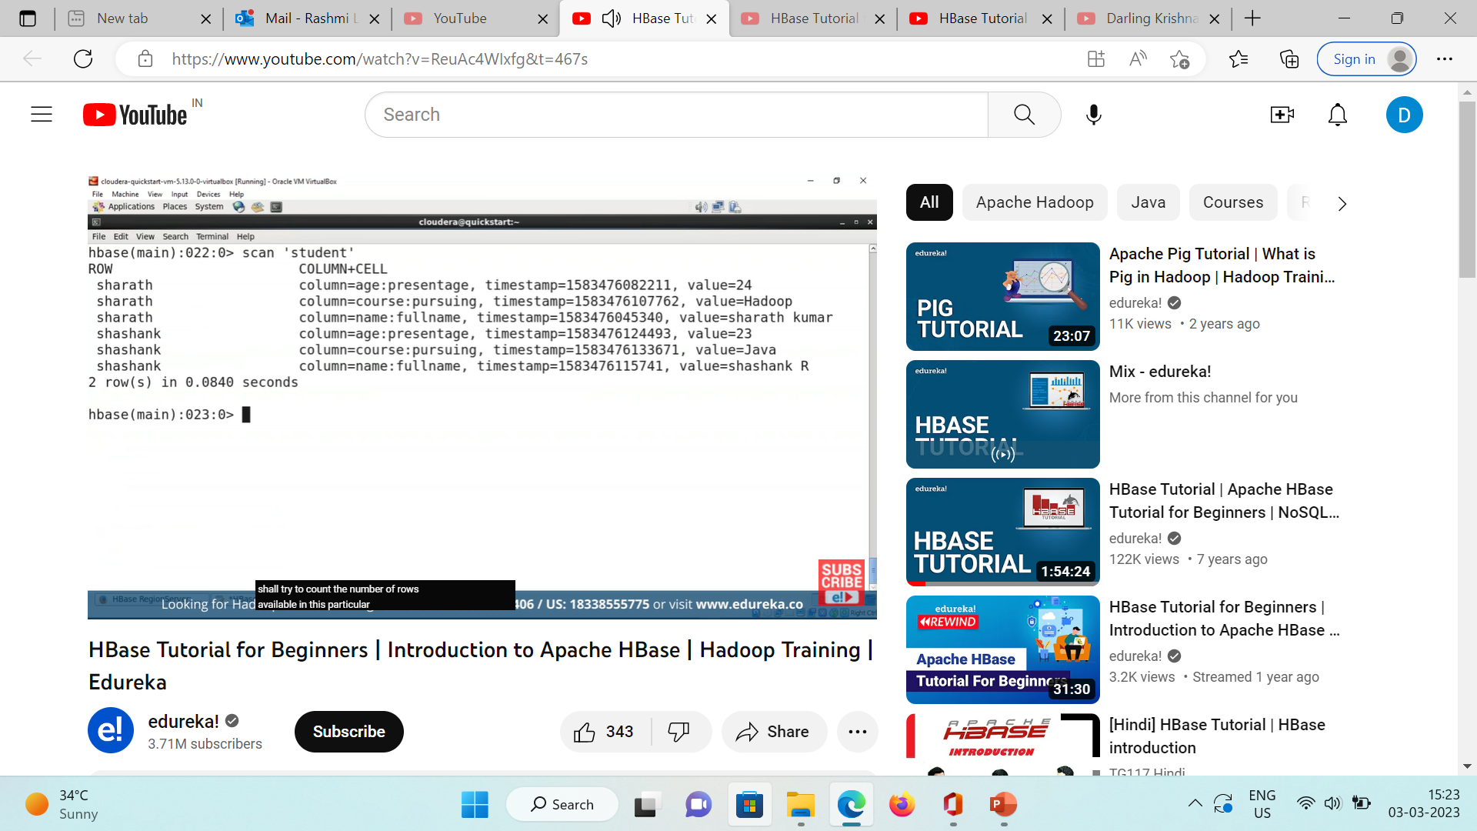
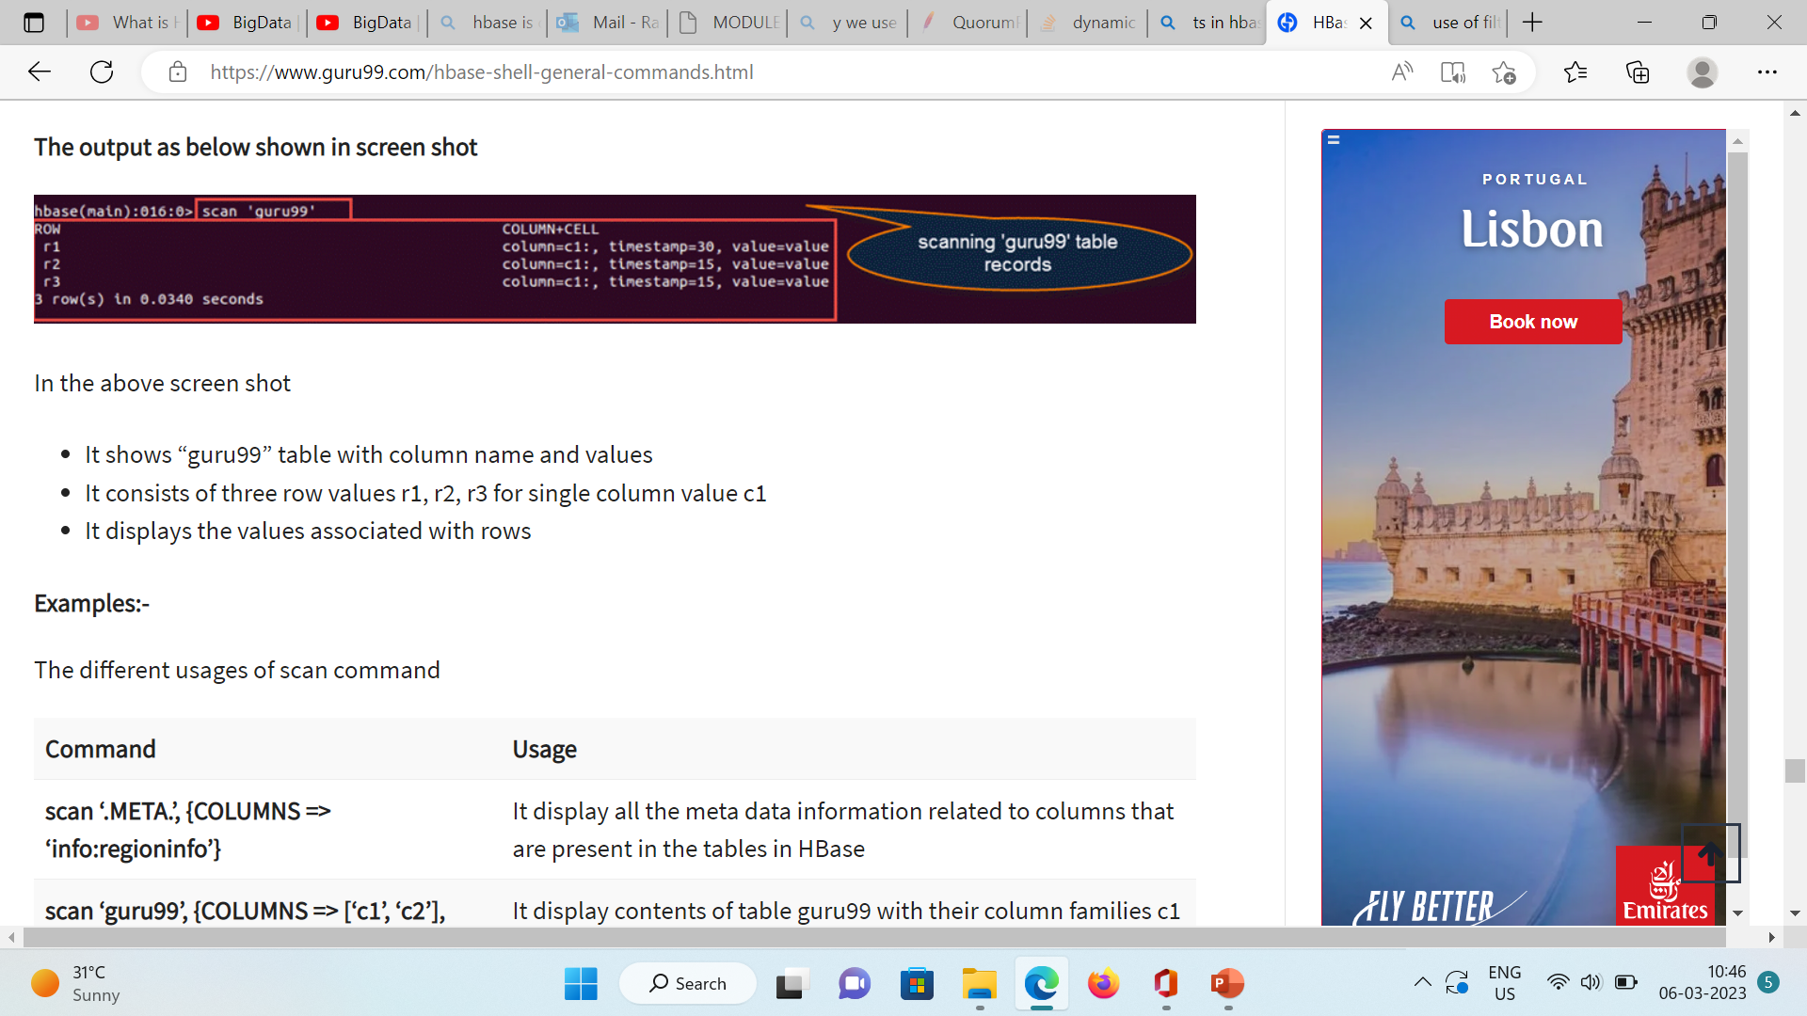
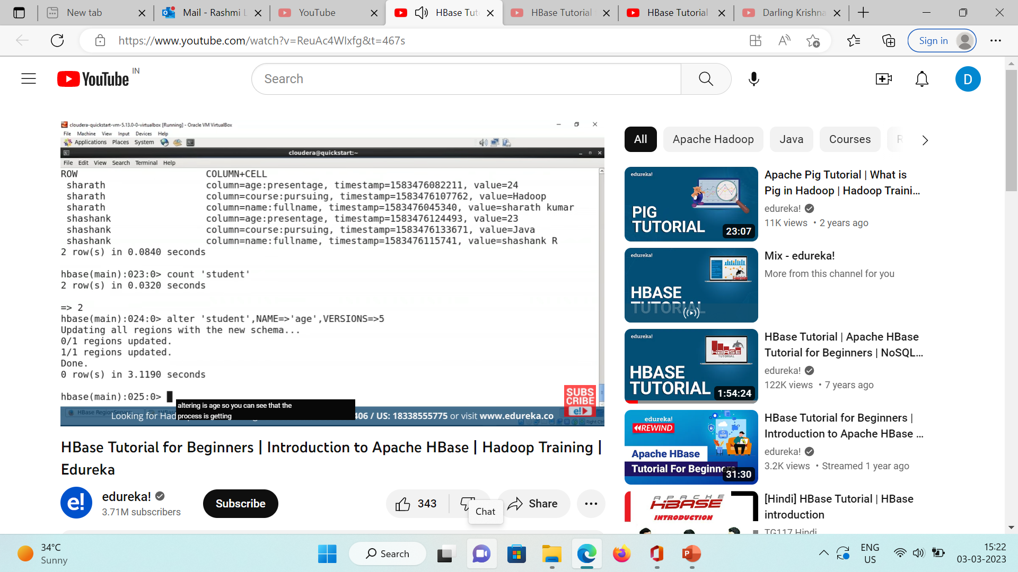

Slide 43
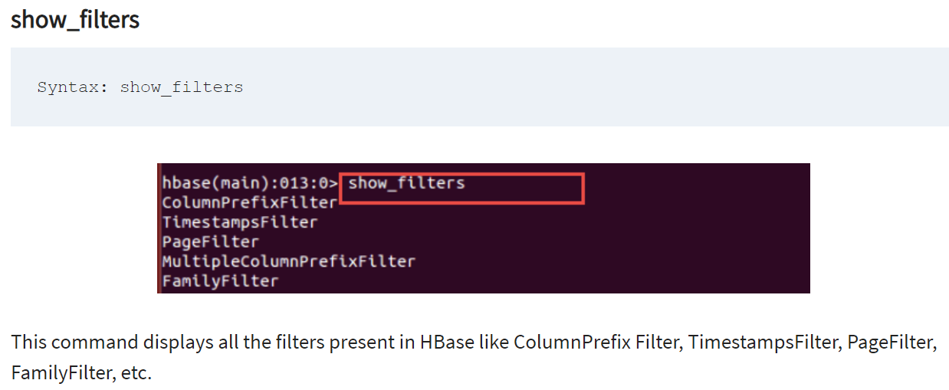
Filtering – Reading data from HBASE using get / scan operations.
Return subset of results to clients.
Inorder to use these filters – import “java” classes to Hbase shell

Slide 44


